Slide 1
Searching Algorithm : Ternary Search
Presented by
Sneha Solanki (240160510048)
Zeel Hirapara (240160510017)
Pooja Joshi (240160510020)

Slide 2
What is Searching ?
Searching is the fundamental process of locating a specific element or item within a collection of data. This collection of data can take various forms, such as arrays, lists, trees, or other structured representations.
It plays an important role in various computational tasks and real-world applications, including information retrieval, data analysis, decision-making processes, and more.

Slide 3
Searching Algorithm
Linear Search
Binary Search
Jump Search
Interpolation Search
Fibonacci Search
Ternary Search
Metabinary Search
But today we learn about Ternary Search

Slide 4
What is Ternary Search?
Ternary search is a search algorithm that is used to find the position of a target value within a sorted array. It operates on the principle of dividing the array into three parts instead of two, as in binary search. The basic idea is to narrow down the search space by comparing the target value with elements at two points that divide the array into three equal parts.
mid1 = l + (r-l)/3
mid2 = r – (r-l)/3

Slide 5
How It’s work
Searching value is at m1 or m2, the process will successfully exist.
If the element is smaller than mid1 The value will be found between l and m1.
The new range is l = l and r = m1.
If the element is greater than mid2 The value will be found between m2 and r.
The new range is l = m2 and r = r.
If the searching element is between m1 and m2
The new range is l = m1 and r = m2.

Slide 6
When we use Ternary Search?
When you have a large ordered array or list and need to find the position of a specific value.
When you need to find the maximum or minimum value of a function.

Slide 7

Working of Ternary Search
Initialization: Set two pointers, left and right, initially pointing to the first and last elements of our search space.
left pointing value:-0
Right pointing value:-9

Slide 8
Working of Ternary Search cont..
Divide the search space:
Calculate two midpoints, mid1 and mid2, dividing the current search space into three roughly equal parts:
mid1 = left + (right – left) / 3 →0+(9-0)/3=9/3=3
mid2 = right – (right – left) / 3 →9-(9-0)/3=6
The array is now effectively divided into [left, mid1], (mid1, mid2), and [mid2, right]
m1 = 3, m2 = 6 Values: 4, 7
0 1 2 3 4 5 6 7 8 9
m1 m2
1 | 2 | 3 | 4 | 5 | 6 | 7 | 8 | 9 | 10

Slide 9
Working of Ternary Search cont..
Comparison with Target cont..
Check the value of m1 and m2:
array[m1] = array[3] = 4
array[m2] = array[6] = 7
Since 6 is greater than 4 but less than 7 we search in the second segment:
New Range: l = 3, r = 6
new left pointing value:-3
new right pointing value:-6

Slide 10
Working of Ternary Search cont..
Comparison with Target cont..
now let’s calculate new mid 1 and new mid 2.
mid1 = left + (right – left) / 3 →3+(6-3)/3=4
mid2 = right – (right – left) / 3 →6-(6-3)/3=5
Check the value of m1 and m2:
array[m1] = array[4] = 5
array[m2] = array[5] = 6
m1 m2
0 | 1 | 2 | 3 | 4 | 5 | 6 | 7 | 8 | 9
1 | 2 | 3 | 4 | 5 | 6 | 7 | 8 | 9 | 10

Slide 11
Working of Ternary Search cont..
Comparison with Target cont..
Since 6 is greater than 5 but equal to 6 we check the value at m2:
Final Check: Found 6 at index 5.
0 | 1 | 2 | 3 | 4 | 5 | 6 | 7 | 8 | 9
1 | 2 | 3 | 4 | 5 | 6 | 7 | 8 | 9 | 10

Slide 12
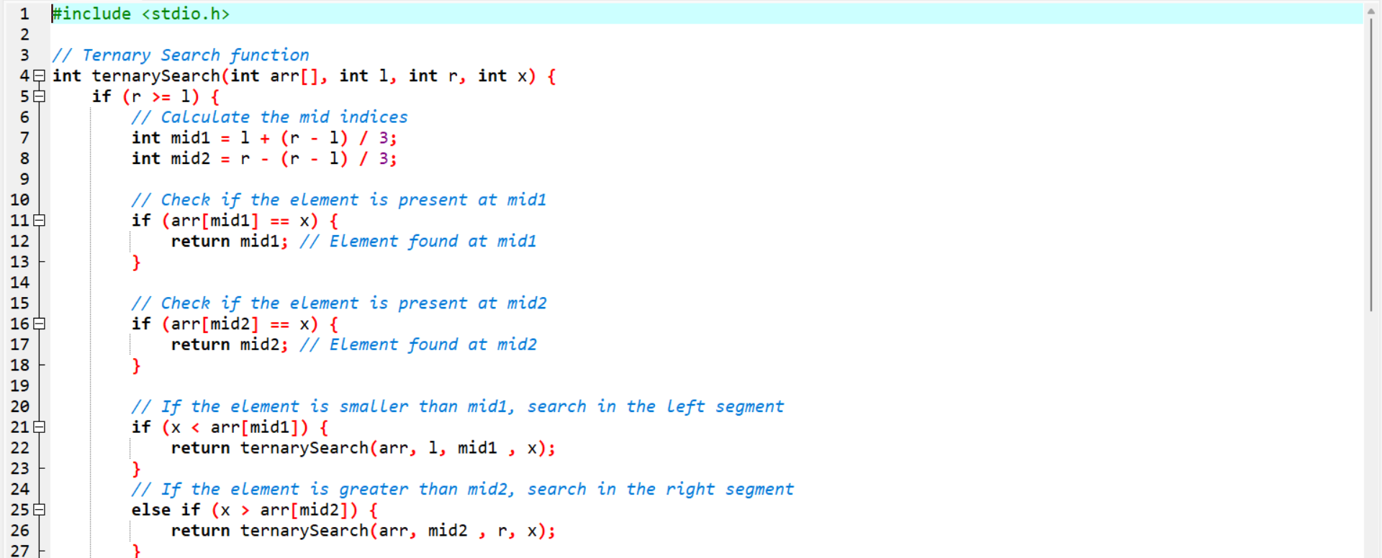
Understand with code

Slide 13
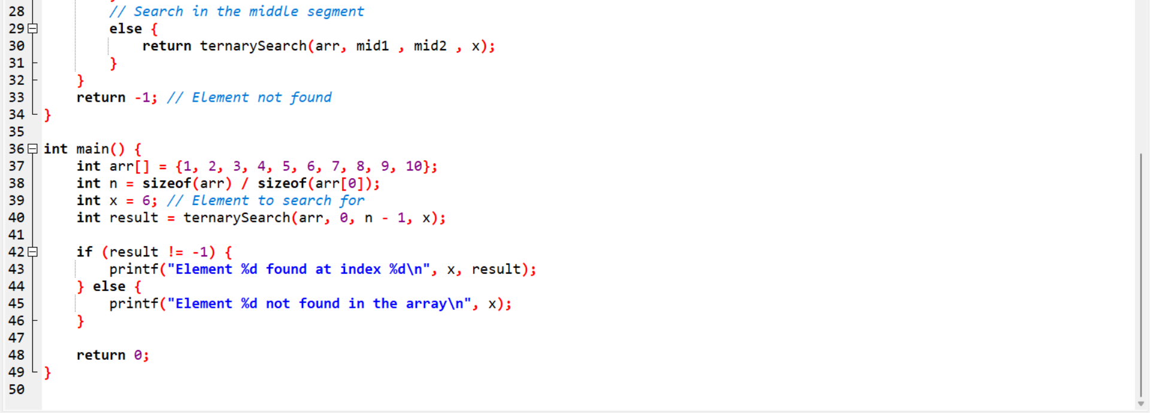
Understand with code cont..

